Slide 1
History Of C
The C programming language was devised in the early 1970s by Dennis M. Ritchie in Bell Labs (AT&T).
The programming language C was written down, by Kernighan and Ritchie, in a book called “The C Programming Language, 1st edition”.
For years the book “The C Programming Language, 1st edition” was the standard on the language C.
In 1983 a committee was formed by the American National Standards Institute (ANSI) to develop a modern definition for the programming language C.

Slide 2
History Of C
In 1988 they delivered the final standard definition ANSI C. (The standard was based on the book from K&R 1st ed.).
The standard ANSI C made little changes on the original design of the C language.
Later on, the ANSI C standard was adopted by the International Standards Organization (ISO).

Slide 3
Importance Of C Language
Robust language: Rich setup of built-in functions and operators.
Portable language: Programs written for one computer system can be run on another system, with little or no modification
Flexible language: Has its ability to extend itself. A c program is basically a collection of functions that are supported by the C library. We can continuously add our own functions to the library with the availability of the large number of functions

Slide 4
Importance Of C Language
Has several variety of data types and powerful operators
Suitable to write both application software as well as system software
Well suited for structured programming. This makes the programmer to think in terms of modules or blocks. This in turn makes program debugging, testing and maintaining easier.

Slide 5
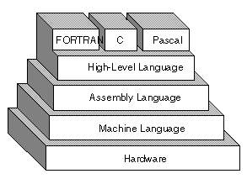
Languages
Machine languages consist entirely of numbers and are almost impossible for humans to read and write.
Assembly languages have the same structure and set of commands as machine languages, but they enable a programmer to use names instead of numbers.
Each type of CPU has its own machine language and assembly language, so an assembly language program written for one type of CPU won't run on another.

Slide 6
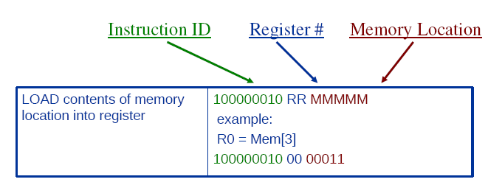
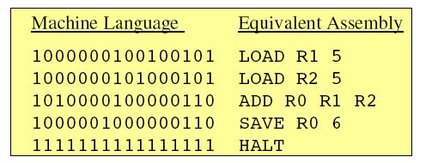
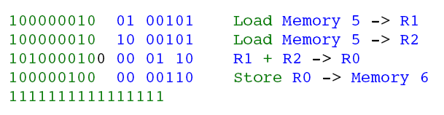
Ex. Machine Language & Assembly Language

Slide 7
High-level and Low-level term are used to differentiate any computer programming language whether it is easily understandable to human or not.
High Level Language | Low Level Language | Middle level language
High Level Language means the language is easily understandable by human High level programming languages are more structured, are closer to spoken language Higher level languages are also easier to read. | Low Level Language means the language is more to a machine language than human understandable language. Ex: Machine Level Language | It supports both high level language and low level language that is machine level language.

Slide 8
C Language
C Programming language is called as Middle Level Language
1. It gives or behaves as High Level Language through Functions - gives a modular programming and breakup, increased efficiency for re-usability
2. It gives access to the low level memory through Pointers. Moreover it does support the Low Level programming i.e, Assembly Language.
As its a combination of these two aspects, its neither a High Level nor a Low level language but a Middle Level Language.

Slide 9
Three C Program Stages
myprog.c
myprog.obj
myprog.exe
SOURCE
OBJECT
EXECUTABLE
Written in
C
(High Level Lang)
Written in
Machine
language
Written in
Machine
language
via compiler
via linker
Other code
from libraries,
etc.
Notes:
7

Slide 10
Compiler, Interpreter, Linker, Loader
Compiler:
It is a program which translates a high level language program into a machine language program. It checks all kinds of limits, ranges, errors etc. It has slow speed. Because a compiler goes through the entire program and then translates the entire program into machine codes.

Slide 11
Interpreter: An interpreter is a program which translates statements of a program into machine code.
It translates only one statement of the program at a time.
It reads only one statement of program, translates it and executes it.
Then it reads the next statement of the program again translates it and executes it. In this way it proceeds further till all the statements are translated and executed.
On the other hand, a compiler goes through the entire program and then translates the entire program into machine codes. A compiler is 5 to 25 times faster than an interpreter.
By the compiler, the machine codes are saved permanently for future reference.
On the other hand, the machine codes produced by interpreter are not saved.

Slide 12
Linker | Loader
In high level languages, some built in header files or libraries are stored. These libraries are predefined and these contain basic functions which are essential for executing the program. These functions are linked to the libraries by a program called Linker. If linker does not find a library of a function then it informs to compiler and then compiler generates an error. The compiler automatically invokes the linker as the last step in compiling a program. | Loader is a program that loads machine codes of a program into the system memory. In Computing, a loader is the part of an Operating System that is responsible for loading programs. It is one of the essential stages in the process of starting a program. Because it places programs into memory and prepares them for execution. Loading a program involves reading the contents of executable file into memory.

Slide 13
Assignment
Difference between:
Compiler & Assembler
Compiler & Interpreter
High Level & Low Level
High Level & Middle Level
Linker & Loader
Assembler & Interpreter

Slide 14
Your First
C PROGRAM !!!!!

Slide 15
C Program File
All the C programs are written into text files with extension ".c" for example hello.c.
C Compilers
When you write any program in C language then to run that program you need to compile that program using a C Compiler which converts your program into a language understandable by a computer.
This is called machine language (ie. binary format). So before proceeding, make sure you have C Compiler available at your computer.

Slide 16
C Program
A C program basically has the following form:
Preprocessor Commands
Functions
Variables
Statements & Expressions
Comments

Slide 17
Simplest C Program
Hash
#include<stdio.h>
int main()
{
printf(“ Programming in C is Interesting”);
return 0;
}

Slide 18
Preprocessor Directive
# include: Is a preprocessor directive which directs to include the designated file which contains the declaration of library functions (pre defined).
stdio.h (standard input output) : A header file which contains declaration for standard input and output functions of the program. Like printf, scanf
When one or more library functions are used, the corresponding header file where the information about these functions will be present are to be included.

Slide 19
Functions
Every C Program will have one or more functions and there is one mandatory function which is called main() function.
This function is prefixed with keyword int which means this function returns an integer value when it exits. This integer value is returned using return statement.

Slide 20
Variables: are used to hold numbers, strings and complex data for manipulation.
Statements & Expressions : Expressions combine variables and constants to create new values. Statements are expressions, assignments, function calls, or control flow statements which make up C programs.
Comments: are used to give additional useful information inside a C Program. All the comments will be put inside /*...*/ as given in the example above. A comment can span through multiple lines.

Slide 21
Note the following:
C is a case sensitive programming language. It means in C printf and Printf will have different meanings.
End of each C statement must be marked with a semicolon.
Multiple statements can be one the same line.
Statements can continue over multiple lines.

Slide 22
Defining main( )
When a C program is executed, system first calls the main( ) function, thus a C program must always contain the function main( ) somewhere.
A function definition has:
heading
{
declarations ;
statements;
}

Slide 23
Basic Structure of a C program
    preprocessor directive
    int main( )
    {
    declarations;
    _________________;
    ______body_______;
    _________________;
    return 0;
    }

Slide 24
Concept of Comment
Comments are inserted in program to maintain the clarity and for future references. They help in easy debugging.
Comments are NOT compiled, they are just for the programmer to maintain the readability of the source code.
Comments are included as
/* ……………..
………………………………*/

Slide 25
Check this out!
#include<stdio.h>
int main()
{
printf(" India won the final cricket match in Sri Lanka ");
return 0;
}

Slide 26
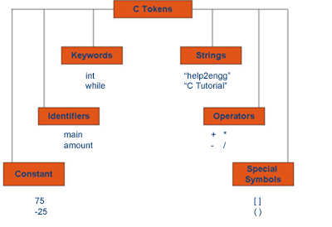
C Tokens
Tokens are individual words and punctuation marks in passage of text. In C, program the smallest individual units are known as C Tokens.
C has Six types of Tokens. The Tokens are shown in figure.

Slide 27
Notion of keywords
Keywords are certain reserved words, that have standard predefined meanings in C.
All keywords are in lowercase.
Some keywords in C:
auto extern sizeof break static case for struct goto switch const if typedef enum signed default int union long continue
unsigned do register void double return volatile else short while float char

Slide 28
Identifiers
In C programming, identifiers are names given to C entities, such as variables, functions, structures etc.
Identifier are created to give unique name to C entities to identify it during the execution of program.
For example:
int money;
int mango_tree;

Slide 29
Identifiers and Variables
Identifier :
  A name has to be devised for program elements such as variables or functions.
Variable:
  Variables are memory regions you can use to hold data while your program is running.
  Thus variable has an unique address in memory region.
  For your convenience, you give them names
Contains only letters, digits and under score characters,
example1, amount, hit_count

Slide 30
Rules for Identifiers
Must begin with either a letter of the alphabet or an underscore character.
Uppercase letters are different than lowercase, example amount, Amount and AMOUNT all three are different identifiers.
Maximum length can be 31 characters.
Should not be the same as one already defined in the library, example it can not be printf / scanf.
No special characters are permitted. e.g. blank space, period, semicolon, comma etc.

Slide 31
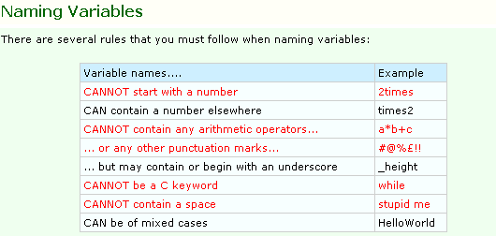

Slide 32
Character set
The character set in C Language can be grouped into the following categories.
1. Letters 2. Digits 3. Special Characters 4. White Spaces
Alphabets:
Uppercase: A B C .................................... X Y Z
Lowercase: a b c ...................................... x y z
Digits:
0 1 2 3 4 5 6 8 9
Special Characters:
Special Characters in C language ,< > . _ ( ) ;$ : % [ ] # ? ‘ & { } “ ^ ! * / | - \ ~ +
White space Characters: blank space, new line, horizontal tab, carriage return

Slide 33
Constants
Constants are the terms that can't be changed during the execution of a program.
In C, constants can be classified as:
Integer constants: Integer constants are the numeric constants without any fractional part or exponential part.
There are 3 types of integer constants in C language: decimal constant(base 10), octal constant(base 8) &hexadecimal constant(base 16).
  Decimal digits: 0 1 2 3 4 5 6 7 8 9
  Octal digits: 0 1 2 3 4 5 6 7
  Hexadecimal digits: 0 1 2 3 4 5 6 7 8 9 A B C D E F.
  For example:
  Decimal constants: 0, -9, 22 etc
  Octal constants: 021, 077, 033 etc
  Hexadecimal constants: 0x7f, 0x2a,

Slide 34
Floating-point constants
Floating point constants are the numeric constants that has either fractional form or exponent form.
For example:1.0, 1.23, 100.002.
E.g., 1.0e10, 1.23e-2, 1.002e+2
-0.22E-5
Note: Here, E-5 represents 10⁻⁵. Thus, -0.22E-5 = -0.0000022.
Character constants
Character constants are the constant which use single quotation around characters. For example: 'a', 'l', 'm', 'F' etc.

Slide 35
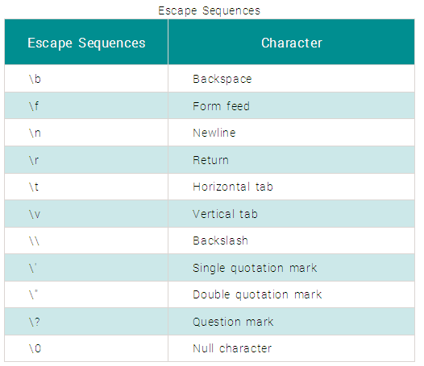
Escape Sequences are used for
  newline(enter),
  tab,
  quotation mark etc. in the program which either cannot be typed or has special meaning in C programming.
For example: \n is used for newline.
The backslash( \ ) causes "escape" from the normal way the characters are interpreted by the compiler.

Slide 36
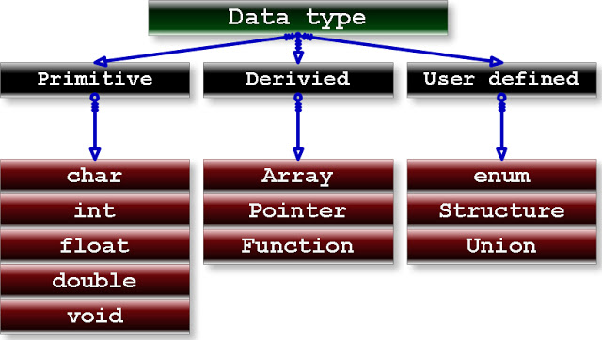
Data Types

Slide 37
Primitive data type
A data type is a classification of data, which can store a specific type of information.
Data types are primarily used in computer programming, in which variables are created to store data.
Each variable is assigned a data type that determines what type of data the variable may contain.
Primitive data types are predefined types of data, which are supported by the programming language.
For example, integer, character, and string are all primitive data types.

Slide 38
Derived Data type
Data types that are derived from fundamental data types are called derived data types.
Derived data types don't create a new data type but, instead they add some functionality to the basic data types.
Ex: Array : An array is a collection of variables of same type. They are stored in contagious memory allocation.
  int a[10];
  User Defined Data type: allows us to define our own types based on other existing data types. In order to do that we shall use keyword typedef

Slide 39
Basic Data Types
In C, there are 5 basic data types:
    char,
    int,
    float
    double
    5. void
Each one has its own properties. For instance, they all have different sizes.
The size of a variable can be pictured as the number of memory slots that are required to store it.

Slide 40
Format specifiers
There are several format specifiers-The one you use should depend on the type of the variable you wish to print out. The common ones are as follows:
Format Specifier | Type
%d | int
%c | char
%f | float
%lf | double
%ld | long
%s | string
To display a number in scientific notation, use %e.
To display a percentage sign, use %%

Slide 41
printf( )
It is used to print message or result on the output screen. It is define in stdio.h header file.
Returns the number of characters it outputs on the screen.
Example:
printf( “Enter the number “);
printf( “ Balance in your account is %d”, bal);
printf(“Balance =%d,Total tax is %f ” ,bal, tax);

Slide 42
scanf( )
scanf( ) : It is used to take input from the user such as numerical values, characters or strings. It is defined in stdio.h
The function returns the number of data items that have been entered successfully.
Example:
int num1,num2,num3;
char var;
printf(“enter the numbers ”);
scanf(“%d%d%d”, &num1,&num2,&num3);
printf(“enter a character”);
scanf(“%c”, &var);

Slide 43
Char Data type
A variable of type char can store a single character.
All character have a numeric code associated with them, so in reality while storing a character variable its numeric value gets stored.
The set of numeric code is called as “ASCII”, American Standard Code for Information Interchange.

Slide 44
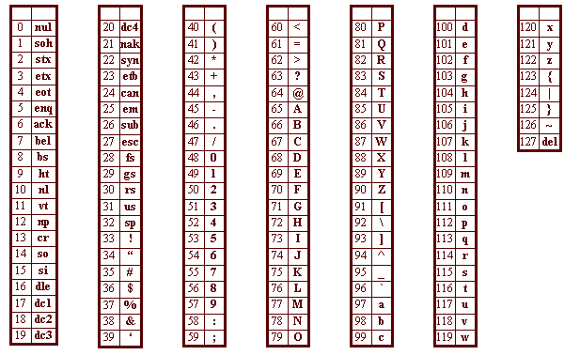
ASCII codes

Slide 45
Declaration of Variable
To declare a variable means to reserve memory space for it.
In the declaration variable is provided a name which is used through out the program.
Example:
char c;
OR
char c, k, l;
Declaring the character does not initialize the variable with the desired value.

Slide 46
Memory view
char type
 |  |  |  |  |  | i
c
Each variable has an unique address of memory location associated with it
integer

Slide 47
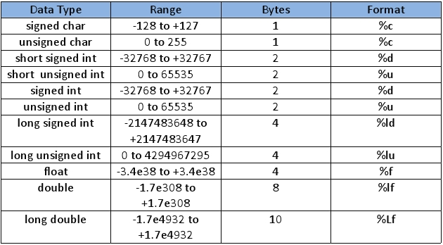
Data types and Ranges

Slide 48
Important about Variable
Always remember in C , a variable must always be declared before it used.
Declaration must specify the data type of the value of the variable.
Name of the variable should match with its functionality /purpose.
Example int count ; for counting the iterations.
float per_centage ; for percentage of student

Slide 49
Char data type
Characters (char) – To store a character into a char variable,you must enclose it with SINGLE QUOTE marks i.e. by ‘ ’.
The double quotes are reserved for string.
The character that you assign are called as character constants.
You can assign a char variable an integer.i.e. its integer value.
  ‘a’, ‘z’ , ‘A’ , ‘Z’ , ‘?’, ‘@’, ‘0’, ‘9’
Notes:
\n = end of line
\t = tab
\0 = end of string
\’ gives single quote
\\ gives backslash

Slide 50
Initialization
Initializing a variable involves assigning(putting in) a value for the first time. This is done by using the ASSIGNMENT OPERATOR, denoted by the equals sign,=.
Equality operator is denoted by (==)
Declaration and initializing can be done on separate lines, or on one line.
char c=‘x’; or char c;
        c=‘x’

Slide 51
Printing value of char variable
printf( “%c”, a);
This causes the “ %c” to be replaced by value of character variable a.
printf(“\n %c”, a);
“\n” is a new line character
which will print the value of variable on newline.

Slide 52
Expressions
Expressions consist of a mixture of constants, variables and operators .They return values.
Examples are:
  17
  -X*B/C+A
  X+17

Slide 53
Program
#include<stdio.h>
main()
{ int a,b,c,d,e;
  a=10;
  b=4.3;
  c=4.8;
  d='A';
  e= 4.3 +4.8;
  printf("\n a=%d",a);
  printf("\n b=%d",b);
  printf("\n c=%d",c);
  printf("\n d=%d",d);
  printf("\n e=%d",e);
  return 0;
  }
a=10
b=4 // b is integer
c=4 // c is integer
d=65 //ASCI value of A is 65
e=9

Slide 54
ASCII codes

Slide 55
Program using character constants
#include<stdio.h>
int main()
  {
    char a,b,c,d;
    char e='o';
    a='H';
    b=o;
    c=“l”;
    d=108; s
    printf("%c%c%c%c%c",a,b,c,d,e);
    return 0;
    }

Slide 56
Program using character constants
#include<stdio.h>
int main()
  {
    char a,b,c,d; /* declare char variables*/
    char e='o'; /* declare char variable*/
    a='H'; /* initialize the rest */
    b='e'; /* b=e is incorrect */
    c='l'; /* c=“l” is incorrect*/
    d=108; /* the ASCII value of l is 108 */
    printf("%c%c%c%c%c",a,b,c,d,e);
    return 0;
    }
Output : Hello would be printed

Slide 57
Integer Data Type
Variables of the int data type represent whole numbers.
If you try to assign a fraction to an int variable,the decimal part is ignored and the value assigned is rounded down from the actual value.
Also assigning a character constant to an int variable assigns the ASCII value.

Slide 58
Float data type
For storing decimal numbers float data type is used.
Floats are relatively easy to use but problems tend to occur when performing division
In general:
An int divided by an int returns an int.
An int divided by a float returns a float.
A float divided by an int returns a float.
A float divided by a float returns a float.

Slide 59
Program
#include<stdio.h>
main( )
  {
    float a=3.0;
    float b= 4.00 + 7.00;
    printf("a=%f" ,a);
    printf("b=%f" ,b);
    return 0;
  }
a=3.000000 b=11.000000

Slide 60
int and float
Float is “ communicable type “
  Example:
        4.0/5 + 2 - 1
        = 0.8 + 2 - 1
        = 1.8
Integer division in C rounds down:
  4/5 = 0

Slide 61
Example
1 + 2 * 3 - 4.0 / 5
= 1 + (2 * 3) - (4.0 / 5)
= 1 + 6 - 0.8
= 6.2

Slide 62
Multiple Format specifiers
You could use as many format specifiers as you want with printf-just as long as you pass the correct number of arguments.
The ordering of the arguments matters. The first one should corresponding to the first format specifier in the string and so on. Take this example:
printf( “a=%d,b=%d, c=%d\n”, a , b, c);
If a,b and c were integers,this statement will print the values in the correct order.
Rewriting the statement as
printf( “a=%d,b=%d, c=%d\n”, c,a,b);
Would still cause the program to compile OK, but the values of a,b and c would be displayed in the wrong order.

Slide 63


Statements

Slide 64
Statements
Which of these are valid:
int = 314.562 * 50;
3.14 * r * r = area;
k = a * b + c(2.5a + b);
m_inst = rate of int * amt in rs;
km = 4;
area = 3.14 * r * r;
S.I. = 400;
Not valid
Not valid
Not valid
Not valid
valid
valid
Not valid

Slide 65
OVERVIEW OF C

Slide 66
The C language
General purpose and Structure programming language.
Rich in library functions and allow user to create additional library functions which can be added to existing ones.
Highly portable: Most C programs can run on many different machines with almost no alterations.
It gives user the flexibility to create the functions, which give C immense power and scope.

Slide 67
Size of data types
Size of data types is compiler and processor types dependent.
The size of data type can be determined by using sizeof keyword specified in between parenthesis
For Turbo 3.0 compiler, usually in bytes
  char -> 1 bytes
  int -> 2 bytes
  float -> 4 bytes
  double -> 8 bytes

Slide 68

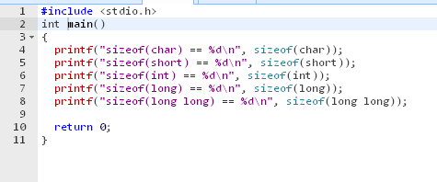
Example Output

Slide 69
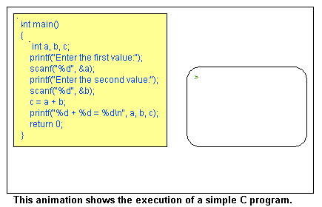

Slide 70
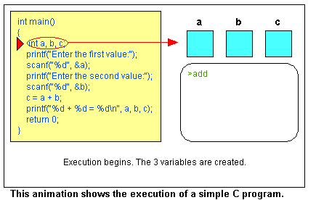

Slide 71
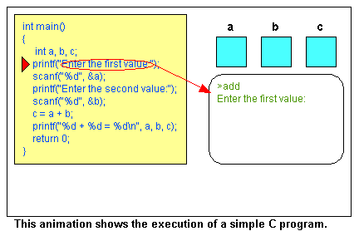

Slide 72
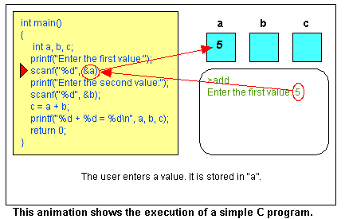

Slide 73
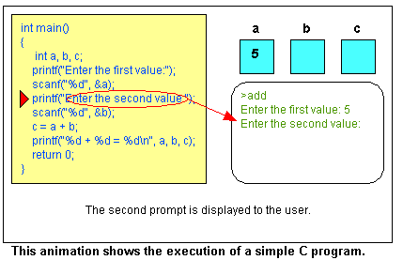

Slide 74
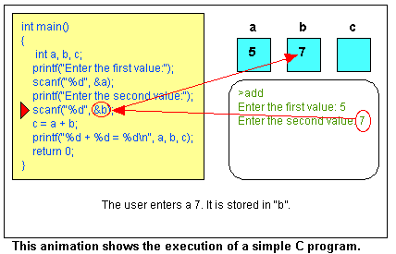

Slide 75
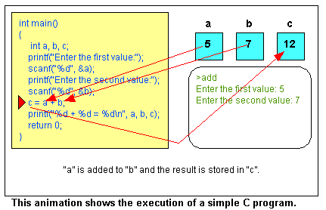

Slide 76
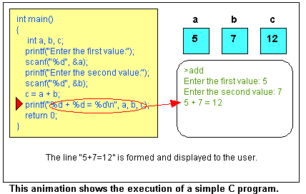

Slide 77
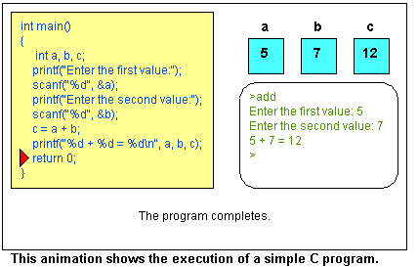

Slide 78
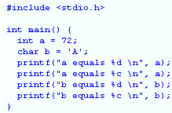
Output??
a equals 72
a equals H
b equals 65
b equals A

Slide 79
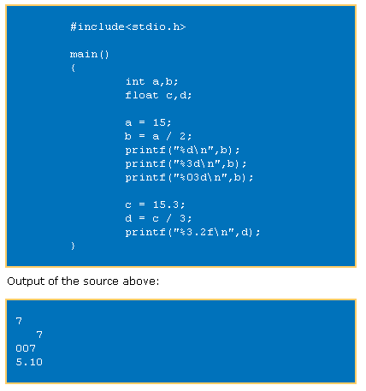
Example Formatting : Printf statement
The first printf statement we print a decimal.
In the second printf statement we print the same decimal, but we use a width (%3d) to say that we want three digits (positions) reserved for the output.
The result is that two “space characters” are placed before printing the character.
In the third printf statement we say almost the same as the previous one.
Print the output with a width of three digits, but fill the space with 0.
In the fourth printf statement we want to print a float.
In this printf statement we want to print three position before the decimal point (called width) and two positions behind the decimal point (called precision).

Slide 80
Formatting Floating Points
%d (print as a decimal integer)
%6d (print as a decimal integer with a width of at least 6 wide)
%f (print as a floating point)
%4f (print as a floating point with a width of at least 4 wide)
%.4f (print as a floating point with a precision of four characters after the decimal point)
%3.2f (print as a floating point at least 3 wide and a precision of 2)

Slide 81
Assignment: Practice on your machine
printf(“%d”,9876)
printf(“%6d”,9876)
printf(“%2d”,9876)
printf(“%-6d”,9876)
printf(“%06d”,9876)
9
8
7
6
9
8
7
6
9
8
7
6
9
8
7
6
0
0
9
8
7
6
If the number is greater than the specified field width, it will be printed in full overridding the minimum specification

Slide 82
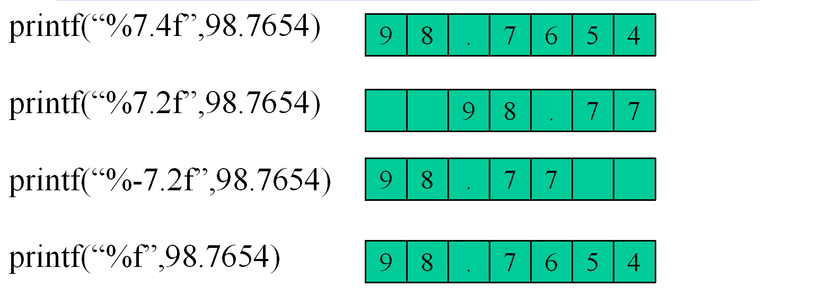
Example
0
0
Note:-Using precision in a conversion specification in the
format control string of a scanf statement is wrong.

Slide 83
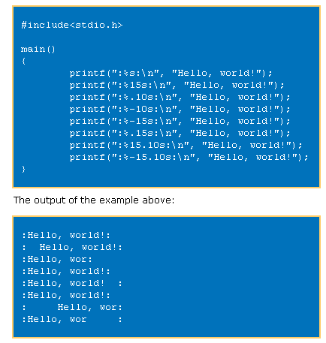

Slide 85
Formatting Strings
The printf(“:%s:\n”, “Hello, world!”); statement prints the string (nothing special happens.)
The printf(“:%15s:\n”, “Hello, world!”); statement prints the string, but print 15 characters. If the string is smaller the “empty” positions will be filled with “whitespace.”
The printf(“:%.10s:\n”, “Hello, world!”); statement prints the string, but print only 10 characters of the string.
The printf(“:%-10s:\n”, “Hello, world!”); statement prints the string, but prints at least 10 characters. If the string is smaller “whitespace” is added at the end.
The printf(“:%-15s:\n”, “Hello, world!”); statement prints the string, but prints at least 15 characters. The string in this case is shorter than the defined 15 character, thus “whitespace” is added at the end (defined by the minus sign.)
The printf(“:%.15s:\n”, “Hello, world!”); statement prints the string, but print only 15 characters of the string. In this case the string is shorter than 15, thus the whole string is printed.
The printf(“:%15.10s:\n”, “Hello, world!”); statement prints the string, but print 15 characters.
If the string is smaller the “empty” positions will be filled with “whitespace.” But it will only print a maximum of 10 characters, thus only part of new string (old string plus the whitespace positions) is printed.
The printf(“:%-15.10s:\n”, “Hello, world!”); statement prints the string, but it does the exact same thing as the previous statement, accept the “whitespace” is added at the end.

Slide 86
Example
#include<stdio.h>
main()
{
printf(":%s:\n", "Hello, world!");
printf(":%15s:\n", "Hello, world!");
printf(":%.10s:\n", "Computer");
printf(":%-10s:\n", "Computer");
printf(":%-15s:\n", "Computer");
printf(":%.15s:\n", "Computer");
printf(":%15.10s:\n", "Computer");
printf(":%15.10s:\n", "Computer Science");
printf(":%-15.10s:\n", "Computer");
printf(":%-15.10s:\n", "Computer Science");
}

Slide 87
Exercise
Write a C program to compute the percentage of a student in five subjects.
  Input the marks in five subjects from the user.
  Maximum marks in all the subjects is 100.

Slide 88
#include<stdio.h>
#include<conio.h>
void main()
{ int m1,m2,m3,m4,m5,total;
float average, percentage;
printf("Enter marks for subject one - ");
scanf("%d",&m1);
printf("Enter marks for subject two - ");
scanf("%d",&m2);
printf("Enter marks for subject three - ");
scanf("%d",&m3);
printf("Enter marks for subject four - ");
scanf("%d",&m4);
printf("Enter marks for subject five - ");
scanf("%d",&m5);
total=m1+m2+m3+m4+m5;
average=total/5;
percentage=(total*100)/500;
printf("\nThe average of five subjects is %f",average);
printf("\nPercentage=%f%%",percentage);
getch(); }

Slide 89
Operators
&
Expressions

Slide 90
Operator
An operator is a symbol used to indicate a specific operation on variables in a program.
Example : symbol “ + “ is an add operator that adds two data items called operands.

Slide 91
Expression
An expression is a combination of operands ( constants, variables, numbers) connected by operators and parenthesis.
Example :
A + B
operator
operand

Slide 92
Types of expression
Arithmetic expression : An expression that involves arithmetic operators. The computed result of this expression is a numeric value.
Logical or Boolean expression : An expression that involves relational and/ or logical operators. The result of this expression is a logical value i.e either 1 (TRUE) or 0 (FALSE)

Slide 93
Operators
C language is very rich in operators.
Four main classes of operators :
        Arithmetic
        Relational
        Logical
        Bit wise

Slide 94
Assignment operator
It is used to assign variable a value: variable_name = expression;
lvalue : In compiler lvalue error messages means that an object on left hand side of assignment operator is missing.
rvalue : In compiler rvalue error messages means that expression on right hand side of assignment operator is erroneous.

Slide 95
Two cases of assignment
Multiple assignment:
int j=k=m=0;
Compound assignment:
j= j+10; this expression can be written as
j + = 10;
similarly
m= m-100; is equivalent to m - = 100;

Slide 96
Arithmetic operators
Following operators are used for arithmetic operations on all built in data types :
        + (addition)
        - (subtraction)
        * (multiplication)
        / (division or quotient)
        % (modulus or remainder)
        -- (decrement)
        ++ (increment)

Slide 97
Precedence
Defines the order in which an expression is evaluated
operators | precedence
* , / , % | High and are on same level
+ , - | Lower and are on same level

Slide 98
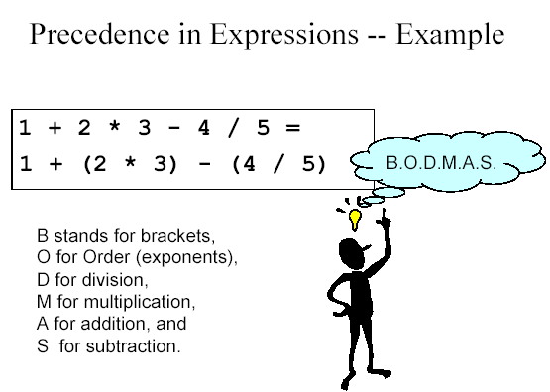

Slide 99
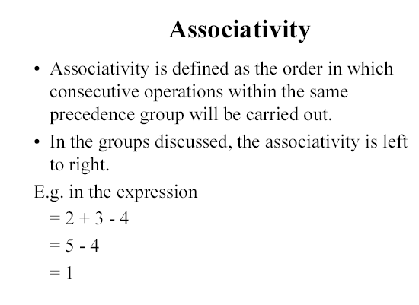

Slide 100
Example
int x;
x= 7 + 3 * 5;
output:
x = 22
int x;
x= ( 7 + 3) * 5;
output:
x = 50
int x;
x= 7 / 3 * 5;
output:
x = 10

Slide 101
Modulus operator ( % )
This operator has same priority as that of multiplication and division
a % b = output remainder after performing a / b
Example:
    7 % 10 = 7
    7%1 = 0
    7 % 2 = 1
    7 % 7 = 0

Slide 102
Exercise
int y;
y = 10 % 4 * 3;
Output:
6
int y;
y = 3 * 10 % 4;
Output::
2

Slide 103
Important
Modulus operator ( % ) : It produces remainder of an integer division. This operator can not be used with floating point numbers.
int main( ){
float f1=3.2, f2=1.1, f3 ;
f3 = f1 % f2;
printf(“ %f”, f3);
return 0; }
Output: error at line 3
illegal use of floating point

Slide 104
Invalid arithmetic expressions
a * + b : Invalid as two operators can not be used in continuation.
a( b * c ) : Invalid as there is no operator between a and b.

Slide 105
Unary arithmetic operators
A unary operator requires only one operand or data item.
Unary arithmetic operators are:
        Unary minus ( - )
        Increment ( + +)
        decrement ( - - )
Unary operators are RIGHT associative that is they are evaluated from right to left when operators of same precedence are encountered in an expression.

Slide 106
Unary minus ( - )
It is written before a numeric value, variable or expression
Its effect is NEGATION of the operand to which it is applied.
Example:
- 57 - 2.933 -x
-( a * b) 8 * ( - ( a+b))

Slide 107
Increment operator ( ++ )
The increment ( ++ ) operator adds 1 to its operand.
n = n +1 ; => ++ n ;
Postfix Increment ( n ++) : It increments the value of n after its value is used.
Prefix Increment ( ++ n) : It increments the value of n before it is used.

Slide 108
Example 1
        x = n++ ;
        x = ++n ;
Where n = 5;
case 1: It sets the value of x to 5 and then increments n to 6.
x = 5 and n= 6
case 2: It increments the value of n and then sets the value of x to 6.
      x = 6 and n =6

Slide 109
Example
sum=x++; sum = ++x;
Sum = x;
x=x+1;
x=x+1;
Sum=x;

Slide 110
Decrement operator
The decrement ( - - ) operator subtracts 1 from its operand.
j = j - 1 ; => -- j;
Postfix decrement ( y - -) : In this case value of operand is fetched before subtracting 1 from it.
Prefix decrement ( - - y) : In this case value of operand is fetched after subtracting 1 from it.

Slide 111
Example
sum=x--; sum = --x;
sum = x;
x=x-1;
x=x-1;
sum=x;

Slide 112
Precedence of Arithmetic operators
Highest : ++ --
- (unary minus)
* / %
Lowest + -
Operators on same level of precedence are evaluated by the complier from left to right.

Slide 113
Exercise
int x= 34.9;
printf ( “\n\t ++x=%d and x++ = %d”,++ x, x++);
++x = 36 and x++ = 34

Slide 114
Relational & Logical operators
A relational operator is used to compare two values and the result of such operation is always logical either TRUE ( 1 ) or FALSE ( 0 ).
        < less than x < y
  > greater than x > y
  <= less than or equal to x <= y
  >= greater than or equal to x >= y
  == is equal to x = = y
  != is not equal to x != y

Slide 115
Exercise
Suppose that i, j, and k are integer variables whose values are 1, 2 and 3, respectively.
Expression
i < j
(i + j) > = k
(j + k) > (i + 5)
k!=3
j = = 2
Value Interpretation
1 true
1 true
0 false
0 false
1 true

Slide 116
Logical operator
A logical operator is used to connect two relational expressions or logical expressions.
The result of logical expressions is always an integer value either TRUE ( 1 ) or FALSE( 0 ).(67 > 5) returns 1
        (67 = = 5) returns 0
    && Logical AND x && y
    || Logical OR x || y
    ! Logical NOT !x

Slide 117
Logic AND
The output of AND operation is TRUE if BOTH the operands are true.
Example: ( 8 < 7 ) && ( 6 > 7)
0 && 0
False ( 0 )

Slide 118
Example 2
    (8 > 7) && (6 < 7)
1 && 1
True ( 1 )

Slide 119
Logical OR
The result of a logical or operation will be true if either operand is true or if both operands are true.
        (8 < 7) | | (6 > 7) is false
        (8 > 7) | | (6 > 7) is true
        (8 > 7) | | (6 < 7) is true

Slide 120
Logical NOT
The Logical NOT ( ! ) is a unary operator. It negates the value of the logical expression or operand.
If value of X = 0 ! X = ?
! X = 1
! ( 5 < 6 ) || ( 7 > 7 ) = ???
! ( 1) || ( 0) = ! 1 = 0 -> false
! ( 5 > 3) = ??
-> 0 -> false
!(34 >= 765) = ??
-> 1 -> True.

Slide 121
Exercise
x = 10 and y = 25
( x > = 10 ) && ( x < 20 )
( x >= 10) && ( y < = 15)
( x = = 10 ) && ( y > 20 )
( x==10) || ( y < 20)
True
False
True
True

Slide 122
Precedence & Associativity
highest
!(logical NOT) ++ -- sizeof( ) | Right to left
* (multiplication) / ( division) %( modulus) | Left to right
+ - (binary ) | Left to right
< <= > >= | Left to right
==(equal to) !=( Not equal to ) | Left to right
&&(AND) | Left to right
|| (OR) | Left to right
? : (conditional ) | Right to left
= += - = * = /= %= | Right to left
, | Left to right
P
R
E
C
E
D
E
N
C
E
lowest

Slide 123
Exercise
Suppose that
  j = 7, an integer variable
  f = 5.5, a float variable
  c = ‘w’
  Interpret the value of the following expressions:
  ( j >= 6) && (c = = ‘w’)
  ( j >= 6) | | ( c = = ‘w’)
  (f < 11) && ( j > 100)
  (c ! = ‘p’) | | ((j + f) <= 10)
  f > 5
  !(f > 5)
  j < = 3
  !( j <= 3)
  j > (f +1)
  !( j > (f +1))
1
1
0
1
1
0
0
1
1
0

Slide 124
Suppose that
  j = 7, an integer variable
  f = 5.5, a float variable
  c = ‘w’
  Interpret the value of the following expressions:
  j + f <= 10
  j >= 6 && c = = ‘w’
  f < 11 && j > 100
  !0 && 0 | | 0
  !(0 && 0) | | 0
0
1
0
0
1

